Slide 1
Capstone Project
By Jane Whelan and Christopher Iwen

Slide 2
Request for proposal
Customer Goals
Customer Constraints
Connect 1050 users and be scalable to accommodate up to 1365 users
Stay competitive
Convenience for students and faculty
Collaboration tools
Limited space
Building codes, inspections, and laws
Budget of 2 million dollars
Inconvenience to students and faculty

Slide 3
Request for proposal
Technical Goals
Technical Constraints
Redundancy without loops
Small failure domains
Equipment able to handle the combined bandwidth of all connections
Set up a central location for administration
Security (security badges, pin numbers, cameras)
Scalability
Space for equipment to have a secure room in each building, and room to run the wires through the ceiling
Security: security badges, pin numbers, cameras, passwords, sticky mac, bdpu guard, firewalls
Server room security

Slide 4
User and administration applications
Cloud storage for the student and faculty
Printing services at each of the buildings
Email server and accounts for each student and faculty member
Wi-Fi in the lobby of each building and in the class rooms for the convenience students, professors, and visitors
DHCP services set up in Horton Hall to give out ip addresses to everyone on the intranet
DNS setup so that network users can get to webpages using a url
NAT overload to facilitate connection of all these users to the internet with a limited number of public ip addresses

Slide 5
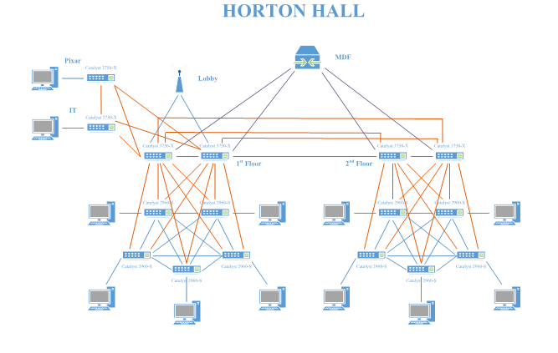
Horton Hall Topology

Slide 6
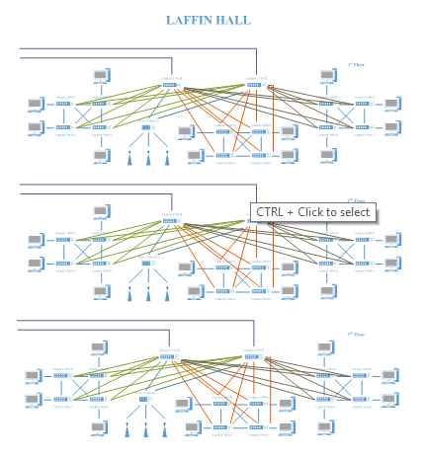
Laffin hall topology

Slide 7
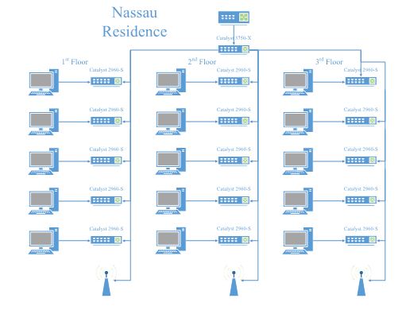
Nassau Residence topology

Slide 8
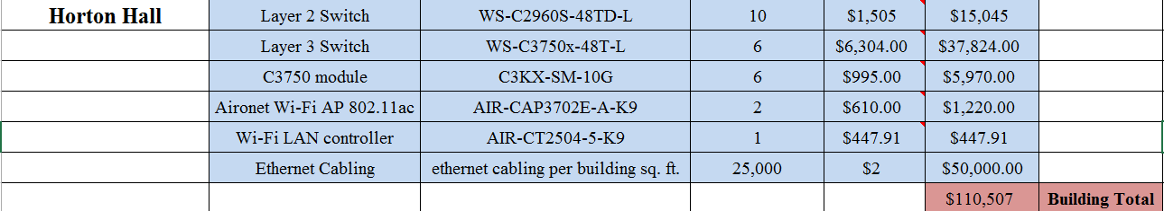
Hortal hall expenses

Slide 9
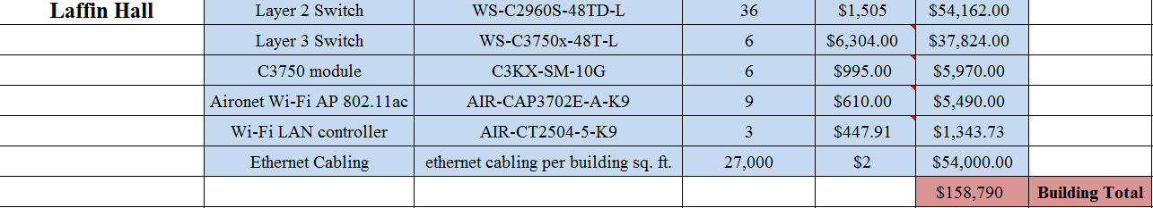
Laffin hall expenses

Slide 10
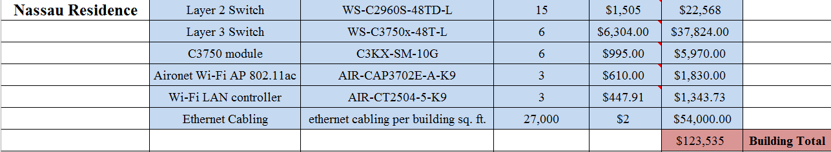
Nassau residence Expenses

Slide 11
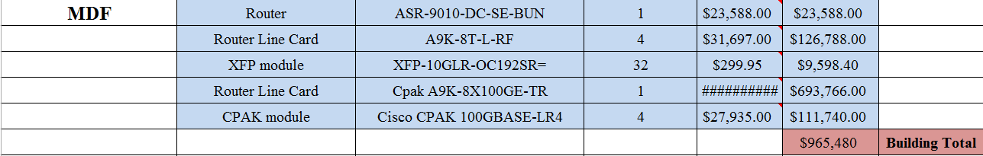
MDF Expenses

Slide 12
Outside work expenses

Slide 13
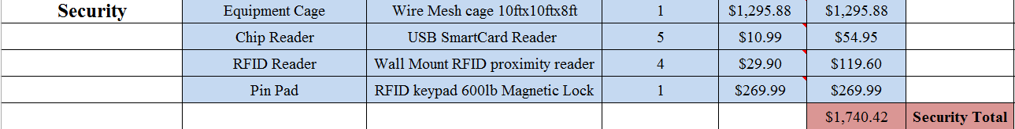
Security Expenses

Slide 14



Grand Total…
$1,403,448

Slide 15
Security
setup access control lists on every Layer 3 device (blocking connections from outside the network)
Using ACL’s to turn off all unused ports (prevent intruders from exploiting a service)
Separate OSPF areas for the DMZ and each building
network DHCP server, private DNS server, and Database server
passwords are required to be at least 10 characters in length and include at least one uppercase, one lowercase, one number, and one special character
will be required to change their passwords every 60 days
Gateway will be setup to drop or deny all pings
will be using Port Address Translation on our edge router to hide the actual IP addresses on our network

Slide 16
Security
Each 3750 switch will be setup to act as a router on a stick and will also be preforming PAT
We will have a total of 70 VLANS. Each 2960 switch will have its own VLAN setup to prevent devices connected to other switches from being able to directly communicate with computers that it shouldn’t
Each buildings switch will be cross connected for redundancy
Our campus wide Wi-Fi will have two SSID’s
Connection to network will require a username and password that is unique and are only given to students and faculty
Physical security we will have cameras on each floor monitoring entrances, exits, hallways, and stairwells. Students and faculty will be required to carry photo id badges with rfid chips to gain access to buildings. The lobby of each building will have a security guard to monitor camera footage, and prevent tampering with devices.

Slide 17
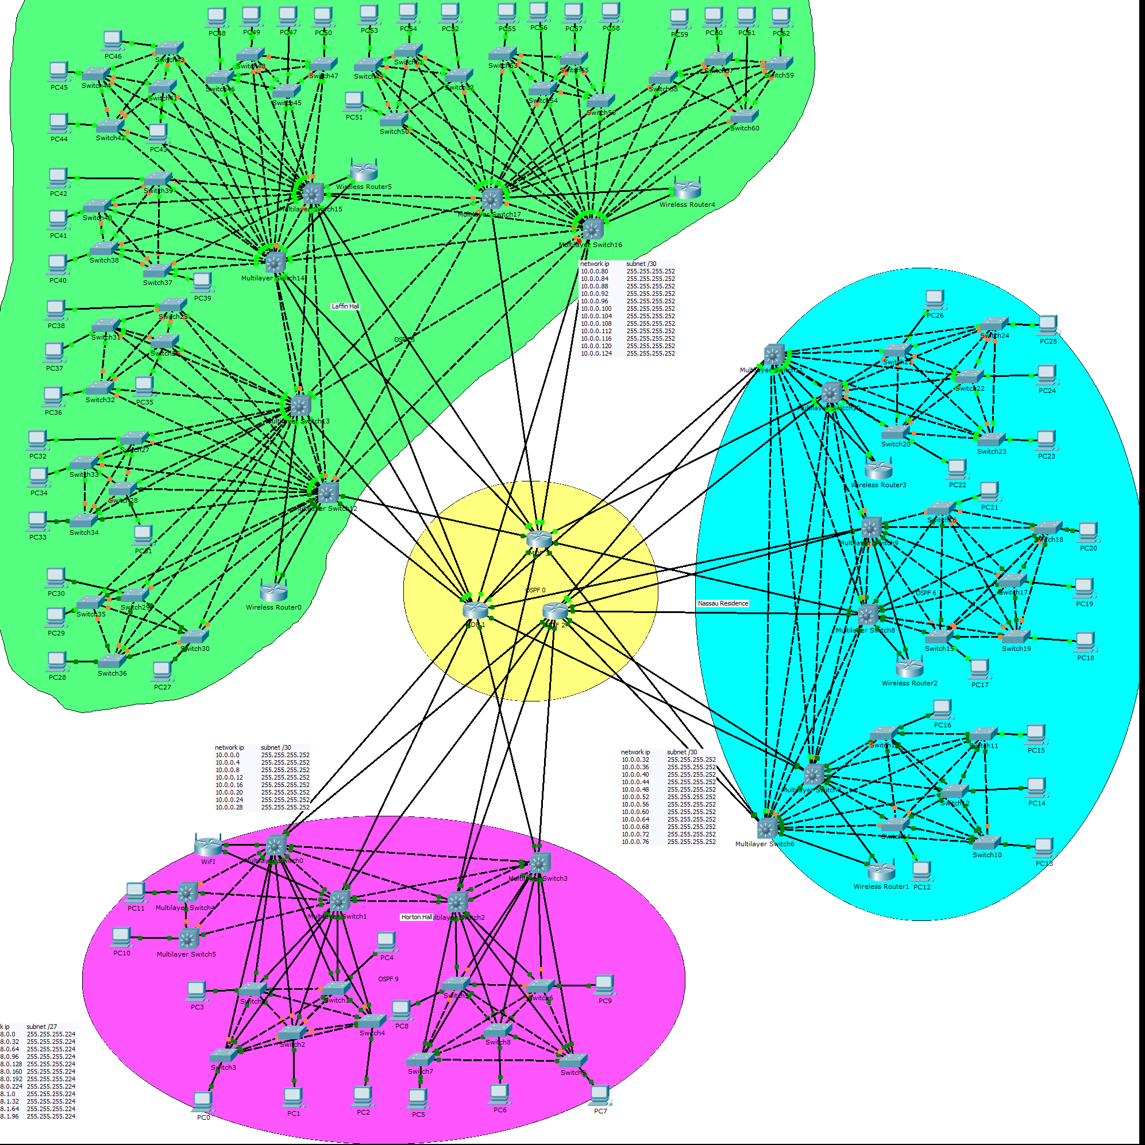
Topology

